Slide 1

Loan Prediction System Using Machine Learning
Group (ɪ)

Slide 2
Meet our Team..
Ruqayya Bala Hadith
rukaiya.hadith@student.neu.edu.ng
Group leader
Yarma Usman
usman.muhammad@student.neu.edu.ng
Model Developer
Abubakar Abdullahi
abubakar.abdullahi@student.neu.edu...
Deployment engineer
Abdulwarith Magaji​
abdulwarith.wala@student.neu.edu.ng
Data Cleaning/Handling
Abubakar Sadiq Ibrahim
abubakar.ibrahim@student.neu.edu.ng
Model Developer
Abdul'adil Dahiru Hassan
abduladl.hassan@student.neu.edu.ng ​
Data Cleaning/Handling

Slide 3

Introduction
Our project is a Loan Approval Prediction System powered by Machine Learning. It helps financial institutions predict whether an applicant is eligible for a loan based on their details. Using real data, we trained models that simplify complex decisions and reduce manual effort.
Notes:
The reason we chose a loan prediction system is because it solves a real, everyday problem.
Every bank or lending institution receives many applications, and manually reviewing each one takes time, effort, and sometimes leads to human bias or inconsistency.
With machine learning, we can automate this decision-making process, making it faster, more consistent, and data-driven.
It also helps reduce the risk of approving loans for applicants who are likely to default, and improves approval rates for those who are genuinely eligible.
So, this system not only helps the lenders, but also gives honest applicants a fairer chance at getting approved.

Slide 4
Why Loan Prediction System??
Problem Statement
Intensive time consumption process of verification and validation.
Human errors can be introduced during the validation process.
No cross-referencing previous loan records.
Lot of human resource required.
Notes:
We chose a loan prediction system because of how crucial and sensitive loan approvals are in real life.
Financial institutions face the challenge of reviewing many applications manually, which is not only time-consuming but also prone to human error and bias.
A machine learning system helps by analyzing past data and learning patterns that can predict whether an applicant is likely to repay the loan or not.
This brings consistency, saves time, and improves decision-making — especially when dealing with a large number of applications.
It's a solution that’s practical, scalable, and relevant to the financial world today.

Slide 5

Problem Solution
Our Machine Learning model calculates all the parameters given and predicts if the applicant is eligible for loan or not in very less time.
Time required for verification and validation reduces significantly.

Slide 6






Software Used
Notes:
For this project, we used a combination of tools and technologies that each played an important role.
We used Python as our core programming language, along with libraries like Pandas for data analysis, NumPy for numerical operations, and Scikit-learn and LightGBM for building and evaluating machine learning models.
For model deployment, the development team used Flask, which allowed us to connect the trained model to a simple web interface.
We also used Jupyter Notebook for experimentation and visualizing data during the development process.
These tools helped us build a system that’s efficient, testable, and easy to maintain.

Slide 7
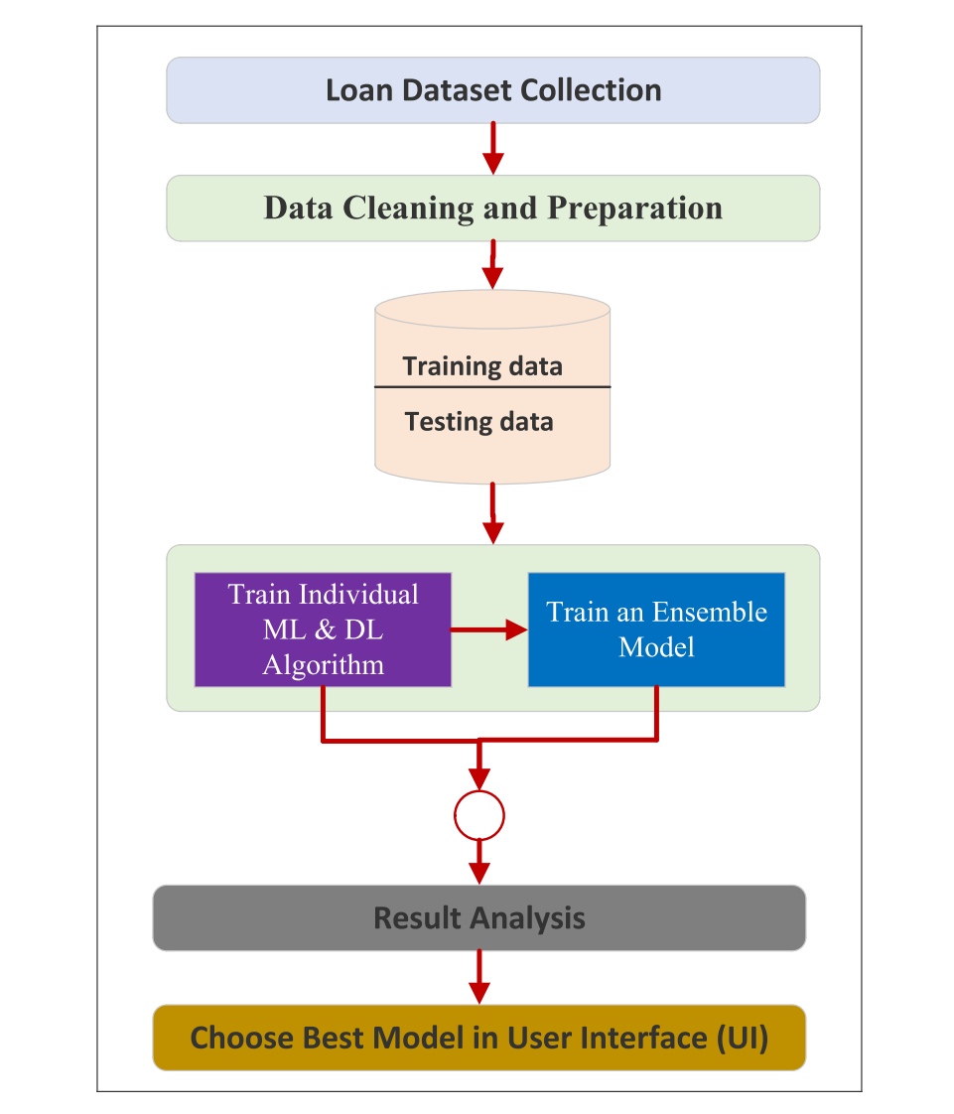
Proposed Work
1)Data Collection-One CSV file is used for this Project.
2) Analyzing Data Analyzing what kind of data we are dealing with.
3)Data Cleaning-Cleaning the Data of any null values, if present.
4)Model Building- After analyzing and cleaning the data we can build ML models.
5)Evaluating Performance Metrics of Models- Evaluating which ML model works best & tuning it.
6) Exporting the model and building the User Interface/Web app using HTML5 & Tailwind CSS.
7) Writing the backend Server Script Using Python3.
8) Connecting Model, backend & frontend.
Notes:
Our proposed work focuses on developing a machine learning system that can predict loan approval based on applicant details.

Slide 8
Models Accuracy
S/N | Model | Accuracy
0 | Light GBM | 73.050847
1 | GradientBoosting | 72.602906
2 | XGBoost | 71.404358
3 | RandomForest Classifier | 69.588378
4 | DecisionTree Classifier | 69.152542
We got our highest accuracy from LightGBM, Which is 73.05%
Notes:
Our three models achieved these accuracies on the test set:
• Logistic Regression:
• Support Vector Machine:
• LightGBM:
LightGBM clearly outperformed the others, so we selected it as our final model.

Slide 9

Light GBM Classifier
LightGBM is a gradient boosting framework used for both classification and regression tasks in machine learning, particularly effective with large datasets. It leverages decision tree algorithms and offers advantages like faster training speed, higher efficiency, and lower memory usage compared to traditional gradient boosting methods.

Slide 10
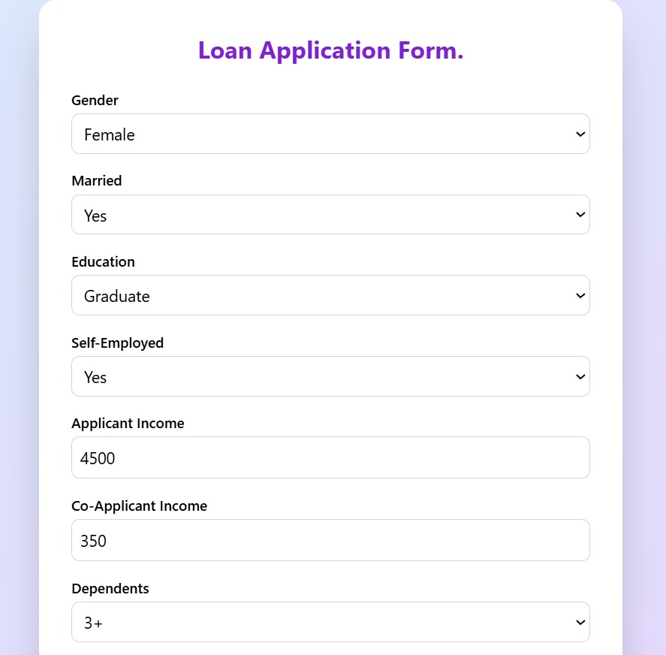
User Interface (UI)
Our user interface is responsive and compatible with all screen sizes

Slide 11
Working
Step 1
Open the Web-app and navigate to the prediction form page where we fill our data

Slide 12
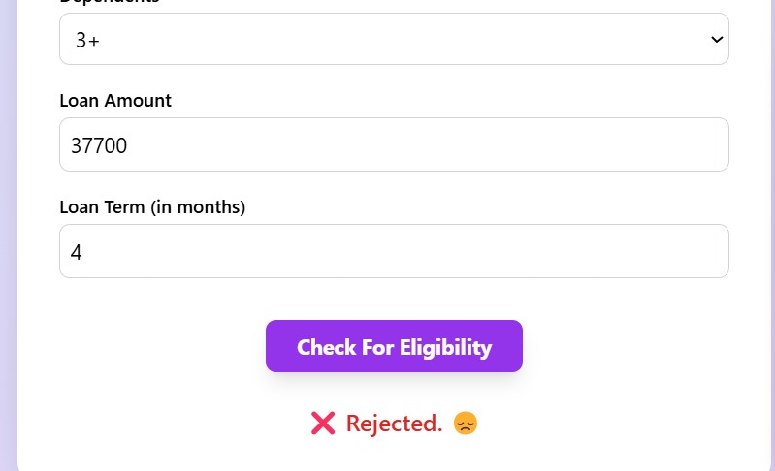
Working...
Step 2
Fill all the data in the given form and press predict button to get the prediction.
Step 3
View the predicted result

Slide 13

Advantages
1) There have been number of cases of input glitches, Human errors in content while filling it manually while in automated prediction system is more secure, reliable.
2) The complexity of filing loan in banks will become much easier as an applicant will knew how much amount of loan he is viable.
3) Machine learning increase the accuracy compare to old traditional system and results get displayed in polar format (yes or no).

Slide 14

Applications
1) In Banking Sector.
2) Co-operate sectors which provides loans to their employees.
3) An individual/applicant who wants to know about his capability of taking loan.

Slide 15
Conclusion and Discussion
The system approved or rejects the loan applications. Recovery of loans is a major contributing parameter in the financial statements of a bank. It is very difficult to predict the possibility of payment of loan by the customer. Machine Learning (ML) techniques are very useful in predicting outcomes for large amount of data. In our project, three machine learning algorithms, Logistic Regression (LR), Decision Tree (DT) and Random Forest (RF) are applied to predict the loan approval of customers. The experimental results conclude that the accuracy of Random Forest machine algorithm is better than compared to Logistic Regression and decision tree machine learning approaches.

Slide 16
Thank You for Listening!!!
stay humble ehh??

